Slide 1

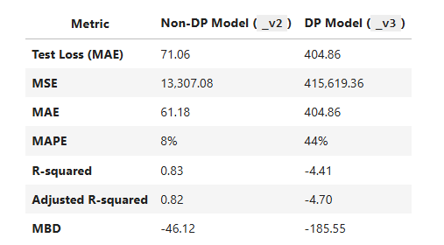
Compare and comment on the accuracy/metrics of the non-DP and DP models
Non-DP model delivers substantially higher accuracy and predictive performance.
DP model introduces significant performance trade-offs due to privacy-preserving mechanisms.
Accuracy degradation makes the DP model less suitable for high-precision tasks.
DP model remains valuable for use cases where data privacy is prioritized over model accuracy.

Slide 2
Comparsion: lakeFS vs DVC
 | LakeFS | DVC
Ease of installation | Moderate – Requires deploying and configuring a server or cloud service | Easy – Installed locally with a single command
Ease of data versioning | High – Git-like versioning of data with strong consistency guarantees | High – Lightweight and scriptable, great for local versioning
Ease of switching between versions for the same model | High – Supports atomic commits, branching, and merging of data versions | Moderate – Requires manual checkout and environment syncing
Effect of DP on model accuracy/metrics | Not handled natively; relies on external differential privacy implementations | Same – DVC does not include built-in DP; accuracy impact depends on external tools

